Slide 1

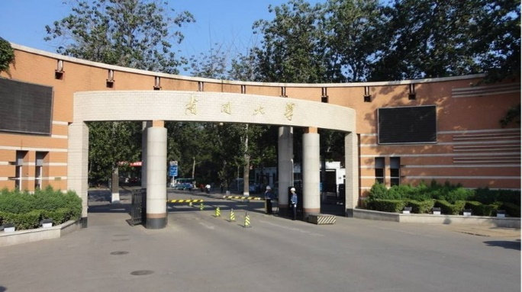
Part 3
Modern Optics
----Blackbody Radiation

Slide 2


Contents
Quantum theory of light
Brief introduction of laser
Nature of light propagation
Fourier Optics
Holography

Slide 3
Quantum theory of light

Slide 4
Quantum theory of light
Blackbody Radiation and Planck’s Quantum Theory
Spectrum of hydrogen atoms
The duality of light

Slide 5
Blackbody Radiation and Planck’s Quantum Theory

Slide 6
Content
Thermal radiation
Black body and Black body radiation
Planck’s quantum theory

Slide 7
Sources of Radiation
In order to be suitable for spectroscopic studies, a source must generate a beam of radiation with sufficient power for easy detection and measurement and its output power should be stable for reasonable periods. Sources are of two types.
1. Continuum sources
2. Line Sources

Slide 8
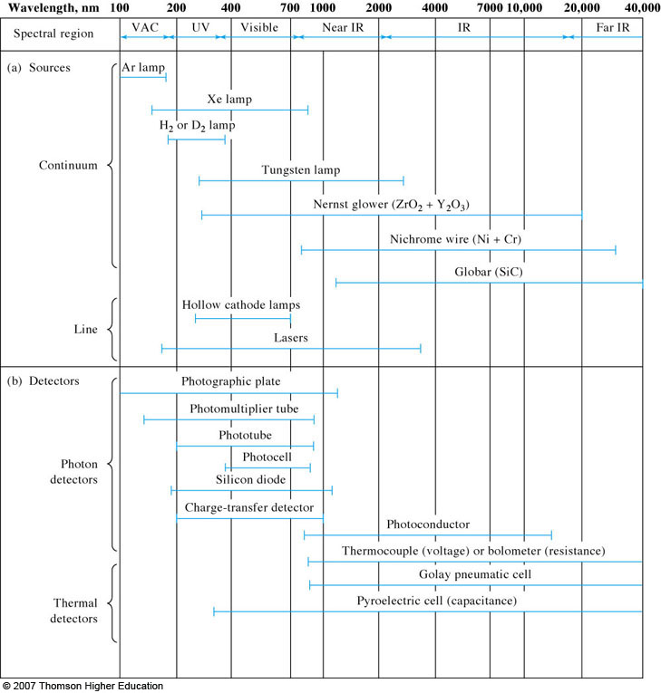

Slide 9
Sources of Radiation
Continuum Sources:
Continuum sources emit radiation that changes in intensity slowly with wavelength.
For the ultraviolet region, the most common source is the deuterium lamp. High pressure gas filled arc lamps that contain argon, xenon, or mercury serve when a particular intense source is required. For the visible region of the spectrum, the tungsten filament lamp is used universally. The common infrared sources are inert solids heated to 1500 to 2000 K.

Slide 10
Sources of Radiation
Line Sources:
Sources that emit a few discrete lines find wide use in atomic absorption spectroscopy, atomic and molecular fluorescence spectroscopy, and Raman spectroscopy.
Mercury and sodium vapor lamps provide a relatively few sharp lines in the ultraviolet and visible. Hollow cathode lamps and electrodeless discharge lamps are the most important line sources for atomic absorption and fluorescence methods.

Slide 11
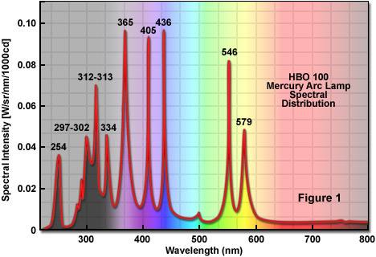
Spectrum of Mercury vapor lamp

Slide 12
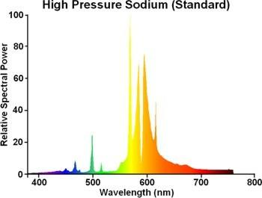
Spectrum of standard high pressure sodium lamps

Slide 13
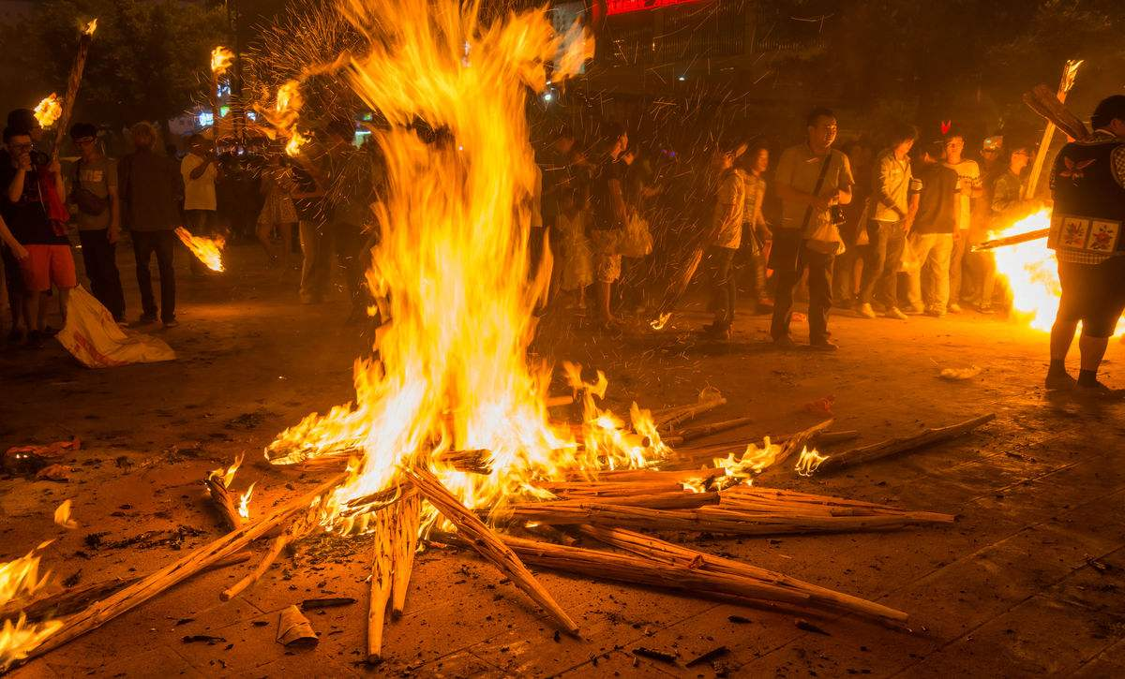
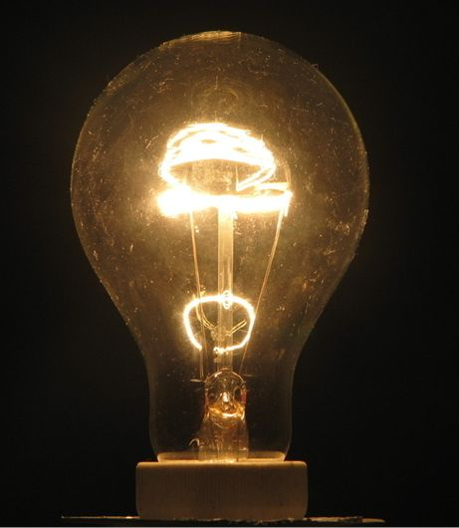
Thermal Radiation
The commonest radiation sources in our daily life are thermal radiation.
Atoms or molecules are always in thermal motion as long as their temperature is not 0K. The thermal motion of atoms or molecules causes light radiate, called as thermal radiation.

Slide 14
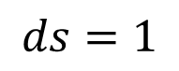
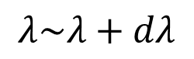
Thermal Radiation
Emission coefficient r(λ,T)
$$λ\sim λ+dλ$$
Energy per unit area per unit time emitted in tiny wavelength rang around from a thermal light source at T into the spatial angle of 2π
$$ds=1$$

Slide 15
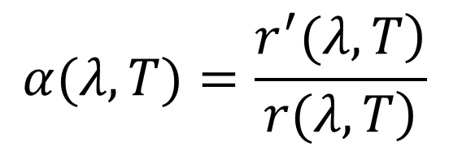
Thermal Radiation
Absorption coefficient α(λ,T)
The fraction of the incident radiant energy absorber per unit area per unit time in that wavelength range
absorbed
$$α(λ,T)=\frac{\left.r^{′}(λ,T\right)}{\left.r(λ,T\right)}$$
incident

Slide 16
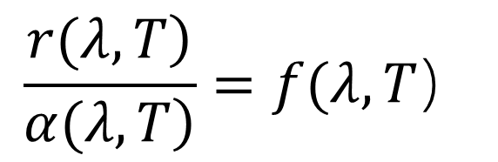
Thermal Radiation
Kirchhoff’s radiation law:
No matter how different the thermal chamber materials are, the energy absorbed at λ must not be equal to the energy radiated. Therefore we have:
$$\frac{\left.r(λ,T\right)}{\left.α(λ,T\right)}=f(λ,T）$$
f(λ,T), is a universal function the same for every type of cavity wall regardless of materials, color, size, and shape. It only depends on T and λ.

Slide 17
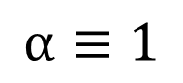
Blackbody
Blackbody (1859)
$$α≡1$$
In this special case, the distribution function is perfectly the same as the blackbody at the same temperature.

Slide 18
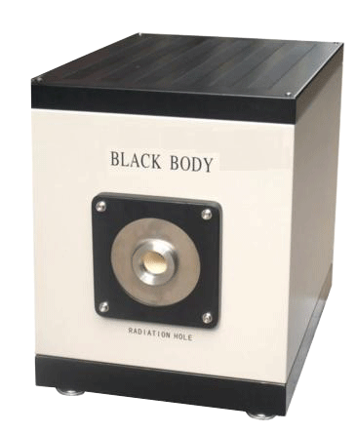
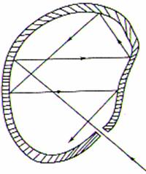
Blackbody
Blackbody
Blackbody is never black!!!
In experiments, the energy emerging from a small hole is a good black object and its radiation is exactly the same as the one of blackbody

Slide 19
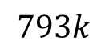


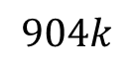



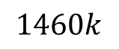
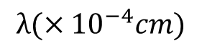
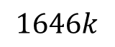

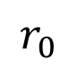
Blackbody
Experimental results of blackbody radiation
$$r_{0}$$
$$1646k$$
$$1460k$$
$$904k$$
$$793k$$
$$0$$
1
$$2$$
$$3$$
$$4$$
$$5$$
$$6$$
$$λ(×{10}^{−4}cm)$$

Slide 20
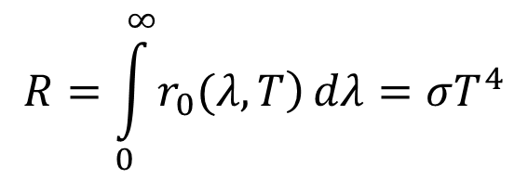
Blackbody
Experimental laws
(a) Stefan-Botzmann law
$$R=\int_{0}^{∞}{\left.r_{0}(λ,T\right)}dλ=σT^{4}$$
R is total radiant power at all wavelengths per unit area of radiating surface, T is the absolute temperature in kelvins and σ=5.67×10⁻⁸W/m²K⁴ is a universal constant.

Slide 21
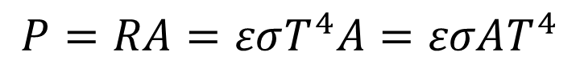
Blackbody
Experimental laws
(a) Stefan-Botzmann law
Most of real objects resemble a blackbody at least at certain temperatures and wavelength. So it is good approximation to write radiated power for a real object as:
$$P=RA=εσT^{4}A=εσAT^{4}$$
Here A is the total radiating area, ε is called total emissivity.

Slide 22
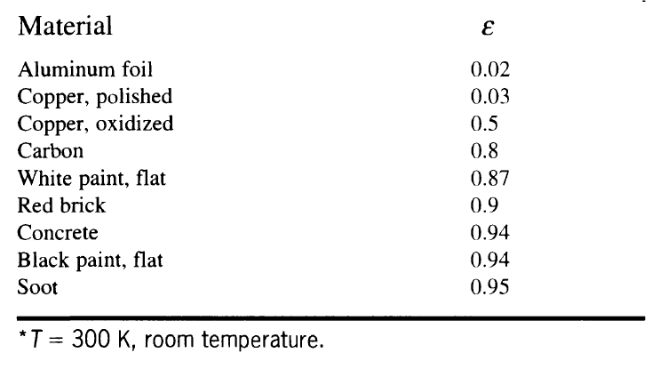
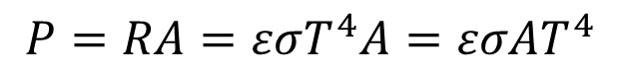
Blackbody
Experimental laws
(a) Stefan-Botzmann law
$$P=RA=εσT^{4}A=εσAT^{4}$$

Slide 23
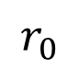
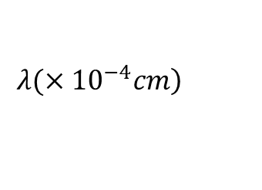
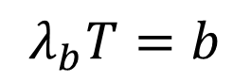

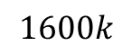
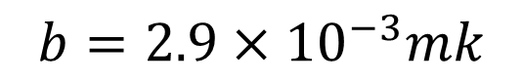



Blackbody
(b) Wien displacement law:
Each blackbody spectral curve reaches a maximum height at a value λ_{b}. The peak wavelength is inversely proportional to the absolute temperature in kelvins.
$$r_{0}$$
$$1600k$$
$$λ_{b}T=b$$
$$b=2.9×{10}^{−3}mk$$
$$0$$
$$2$$
$$4$$
$$6$$
λ_{b}
$$\left.λ(×{10}^{−4}cm\right)$$

Slide 24
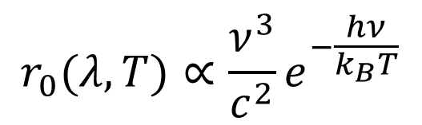
Classical theory of BR
Wien approximation (1896)
Wien assumed the radiation frequencies are proportional to the kinetic energy of thermal motion of the molecules inside the cavity. According to statistical physics, molecules follows Maxwell speed distribution. So we got
$$r_{0}(λ,T)∝\frac{ν^{3}}{c^{2}}e^{−\frac{hν}{k_{B}T}}$$

Slide 25
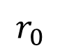
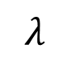
Classical theory of BR
The Wien’s formula fits very well the experimental results in short wavelength region deviate from the data in long wavelength.
$$r_{0}$$
Experiment data
Wien’s line
$$λ$$

Slide 26
Classical theory of BR
Rayleigh-Jeans’ formula
Rayleigh and Jeans indicated that, in the thermal-balanced cavity, the electromagnetic wave must satisfy the condition of standing waves condition. Each standing wave is one eigen mode of the radiation source. And statistical rules are correct for the analysis.

Slide 27
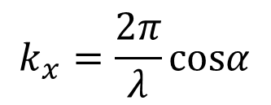
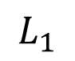
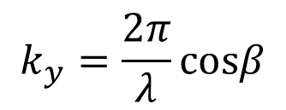
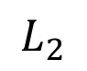
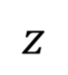
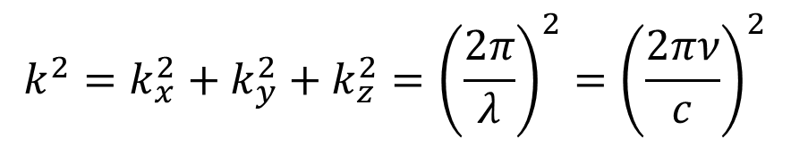
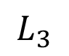
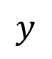
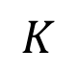
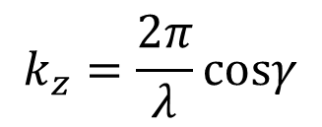
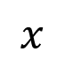
Classical theory of BR
Eigen mode amount in ν～ν+dν
For simplicity, we discuss a rectangular cavity with side length of L₁, L₂ and L₃. The wave vector of the any 3-dimentional wave is:
$$k^{2}=k_{x}^{2}+k_{y}^{2}+k_{z}^{2}={\left(\frac{2π}{λ}\right)}^{2}={\left(\frac{2πν}{c}\right)}^{2}$$
$$z$$
$$k_{x}=\frac{2π}{λ}cosα$$
$$k_{y}=\frac{2π}{λ}cosβ$$
$$K$$
$$L_{3}$$
$$y$$
$$L_{1}$$
$$k_{z}=\frac{2π}{λ}cosγ$$
$$L_{2}$$
$$x$$

Slide 28
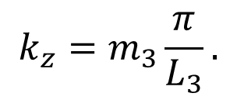
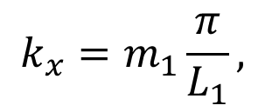
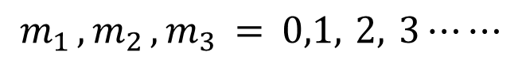
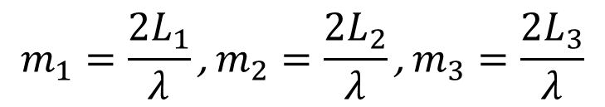
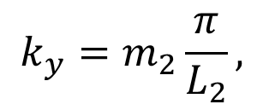
Classical theory of BR
Considering the standing wave conditions in the rectangular cavity, we have serials of integers:
$$m_{1}=\frac{2L_{1}}{λ}\text{, }m_{2}=\frac{2L_{2}}{λ}\text{, }m_{3}=\frac{2L_{3}}{λ}$$
$$m_{1 },m_{2 },m_{3} = 0,1, 2, 3⋯⋯$$
So the components of k along x, y and z axis are not random. They are discrete.
$$k_{x}=m_{1}\frac{π}{L_{1}},$$
$$k_{y}=m_{2}\frac{π}{L_{2}},$$
$$k_{z}=m_{3}\frac{π}{L_{3}}.$$

Slide 29
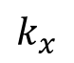
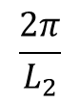
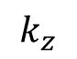






Classical theory of BR
So we have:
$$k^{2}=π^{2}\left[{\left(\frac{m_{1}}{L_{1}}\right)}^{2}+{\left(\frac{m_{2}}{L_{2}}\right)}^{2}+{\left(\frac{m_{3}}{L_{3}}\right)}^{2}\right]={\left(\frac{2πν}{c}\right)}^{2}$$
$$k_{z}$$
Consider the k-space. The allowing states compose an orthogonal lattice with periods of:
$$\frac{π}{L_{3}}$$
$$\left(\frac{π}{L_{1}}\text{, }\frac{π}{L_{2}}\text{, }\frac{π}{L_{3}}\right)$$
$$k_{y}$$
$$k_{x}$$
$$\frac{π}{L_{1}}$$
$$\frac{π}{L_{2}}$$
$$\frac{2π}{L_{2}}$$

Slide 30






Classical theory of BR
The coordinates in k-space of all modes are:
$$\left(m_{1}\frac{π}{L_{1}}, m_{2}\frac{π}{L_{2}}, m_{3}\frac{π}{L_{3}}\right)$$
Here, m_{i} ≥ 0, i.e. the states exist only in the first quartile.
Each mode occupies a volume in k-space:
$$\frac{π}{L_{3}}$$
$$V_{m}=\frac{π}{L_{1}}⋅\frac{π}{L_{2}}⋅\frac{π}{L_{3}}=\frac{π^{3}}{L_{1}L_{2}L_{3}}=\frac{π^{3}}{V}$$
$$\frac{π}{L_{1}}$$
$$\frac{π}{L_{2}}$$
$$\frac{2π}{L_{2}}$$

Slide 31


Classical theory of BR
In k-space, all states with frequencies of 0～ν cover a 1/8 sphere with a radium of:
$$k=\frac{2πν}{c}$$
The total volume of all modes in k-space is:
$$V_{T}=\frac{1}{8}⋅\frac{4}{3}π{\left(\frac{2πν}{c}\right)}^{3}=\frac{4}{3}⋅\frac{π^{4}ν^{3}}{c^{3}}$$

Slide 32


Classical theory of BR
So the total mode amount in the cavity is
$$N=2⋅\frac{V_{T}}{V_{m}}=\frac{8}{3}⋅\frac{πν^{3}}{c^{3}}V$$
Here the factor 2 comes from the two polarization state, i.e. the degeneracy of light.
Take the differential of the above formula of d, we have the mode amount between ν～ν+dν
$$dn=\frac{8πν^{2}}{c^{3}}dν$$

Slide 33

Classical theory of BR
According to energy equipartition theorem, each eigene vibration mode in the cavity have kinetic and potential energy of k_{B}T/2. So the energy density ρ(ν,Τ) in the cavity at ν～ν+dν can be written as:
$$ρ(ν,T)dν=\frac{8πν^{2}}{c^{3}}k_{B}Tdν$$
Here k_{B} is Bolzmann constant.

Slide 34

Classical theory of BR
Relation between r and ρ
d Ω
Use the same strategy in the air pressure calculation from the molecule collision mode. On a unit cavity surface area, in unit time and a solid angle of dΩ, and at direction θ, the emission coefficient is
Hole with dS=1
cavity
$$dr_{0}(ν,T)=\frac{c}{4π}ρ (ν,T)cosθdΩ$$

Slide 35



Classical theory of BR
Integrate dr(ν, T) we have:
$$\begin{matrix}r_{0}(ν,T)=\frac{1}{4π}\int_{0}^{2π}{ \int_{0}^{\frac{π}{2}}{c}}ρ (ν,T)cosθsinθdθdφ \\ \\ \end{matrix}$$
$$=\frac{2π}{c^{2}}ν^{2}k_{B}T$$
$$=\frac{c}{4}ρ(ν,T)$$

Slide 36

Classical theory of BR
Better physics gets worse results!!!!!!
Ultraviolat
catastrophe
$$r_{0}$$
Rayleigh-Jeans line
Experimental data
Wien’s result
$$λ$$

Slide 37


Planck’s quantum theory
Planck radiation law
The total energy of an oscillator should be able to apportioned into energy elements to make energy countable. These energy elements are proportional to the frequency ν of the resonator. Energy must be 0, ε₀ , 2ε₀ , 3ε₀ ,…,nε₀,…
$$ε_{0}=hν$$
$$h=6.626×{10}^{−34}J⋅s,$$
Plank’s Constant

Slide 38
Planck’s quantum theory
In statistic physics, we always count the amount of atoms, molecules, states, modes and so on. Now we try to count energy.
Plank’s work revealed that energy in the nature is always quantized, although Planck stumbled this point. He did not want to break the classical theory. Einstein performed deeper thinking and make the quantized energy widely accept for physicists.

Slide 39


Planck’s quantum theory
According to Boltzmann’s law, the probability of vibration with energy of E is proportional to:
$$e^{−\frac{E}{k_{B}T}}$$
So the probability ratio for different quantized modes in a cavity is:
$$1:e^{−\frac{ε_{0}}{k_{B}T}}:e^{−\frac{{2ε}_{0}}{k_{B}T}}:e^{−\frac{{3ε}_{0}}{k_{B}T}}⋯$$

Slide 40

Planck’s quantum theory
So the average energy inside the cavity is
$$\overline{ε}=\frac{\sum_{m=0}^{∞}{mε_{0}e^{−\frac{mε_{0}}{k_{B}T}}}}{\sum_{m=0}^{∞}{e^{−\frac{mε_{0}}{k_{B}T}}}}=\frac{ε_{0}}{e^{\frac{ε_{0}}{k_{B}T}}−1}=\frac{hν}{e^{\frac{hν}{k_{B}T}}−1}$$

Slide 41


Planck’s quantum theory
Energy density between ν ~ ν+dν inside the cavity is:
$$ρ(ν)dν=\overline{ε}⋅dn=\frac{8πhν^{3}}{c^{3}}⋅\frac{1}{e^{\frac{hν}{k_{B}T}}−1}⋅dν$$
Recalling the formula:
$$dn=\frac{8πν^{2}}{c^{3}}dν$$

Slide 42



Planck’s quantum theory
Now we reach Planck’s radiation law:
$$r_{0}(ν,T)=\frac{c}{4}ρ (ν,T)$$
$$=\frac{\text{2}πhν^{3}}{c^{2}}⋅\frac{1}{e^{\frac{hν}{k_{B}T}}−1}$$
$$=\frac{\text{2}πhc^{2}}{λ^{5}}⋅\frac{1}{e^{\frac{hc}{λk_{B}T}}−1}$$

Slide 43



Planck’s quantum theory
Short wavelength approximation.
With the assumption hν $≫$ k_{B}T,
$$e^{\frac{hν}{k_{B}T}}≫1$$
Planck’s formula can be written as:
$$r_{0}(ν,T)=\frac{\text{2}πhν^{3}}{c^{2}}⋅\frac{1}{e^{\frac{hν}{k_{B}T}}}=\frac{\text{2}πhν^{3}}{c^{2}}e^{−\frac{hν}{k_{B}T}}$$
Wien’s formula

Slide 44




Planck’s quantum theory
Long wavelength approximation.
With the assumption hν $≪$ k_{B}T,
$$e^{\frac{hν}{k_{B}T}}≈1$$
By using Taylor’s expansion:
$$e^{\frac{hν}{k_{B}T}}=1+\frac{hν}{k_{B}T}$$
we have
$$r_{0}(ν,T)=\frac{\text{2}πhν^{3}}{c^{2}}⋅\frac{1}{ \frac{hν}{k_{B}T} }=\frac{\text{2}πk_{B}Tν^{2}}{c^{2}}$$
Rayleigh-Jeans’ formula

Slide 45
Part 3
Modern Optics
---- Spectrum of hydrogen atoms

Slide 46
Contents
Quantum theory of light
Brief introduction of laser
Nature of light propagation
Fourier Optics
Holography

Slide 47
Quantum theory of light
Blackbody Radiation and Planck’s Quantum Theory
Spectrum of hydrogen atoms
The duality of light

Slide 48
Spectrum of hydrogen atoms

Slide 49

Line Spectra
The spectrum produced by a gas or vapour (following an electric discharge) contains only a few wavelengths (colours) and some of the wavelengths are missing. This is called a Line Spectrum. Each atom has its own spectrum.
Line spectra of some elements
The existence of these lines cannot be explained by classical Physics

Slide 50

Emission (line) spectra of some elements

Slide 51

Hydrogen spectrum

Slide 52


Hydrogen spectrum
Figure shows hydrogen spectral lines in the visible region. These were the first lines to be discovered. There are 4 lines at 410.2 nm, 434.1 nm, 486.2nm and 656.3 nm (red). These lines form the Balmer series named after the J.J. Belmer who came up with an empirical formula for the wavelengths of these lines(1884).
$$\frac{1}{λ}=R\left(\frac{1}{2^{2}}−\frac{1}{n^{2}}\right) where..n=3,4,5......$$
R (Rydberg constant) = 1.097 x10⁷ m⁻¹

Slide 53


Hydrogen spectrum
Later other series were discovered in the UV and IR region
Lyman Series: UV region
Paschen Series : IR region
$$\frac{1}{λ}=R\left(\frac{1}{1^{2}}−\frac{1}{n^{2}}\right)where..n=2,3,4......$$
$$\frac{1}{λ}=R\left(\frac{1}{3^{2}}−\frac{1}{n^{2}}\right)where..n=4,5,6......$$

Slide 54


Hydrogen spectrum
Brackett Series: IR region
Pfund Series ; IR region
$$\frac{1}{λ}=R\left(\frac{1}{4^{2}}−\frac{1}{n^{2}}\right)where..n=5,6,7......$$
$$\frac{1}{λ}=R\left(\frac{1}{5^{2}}−\frac{1}{n^{2}}\right)where..n=6,7,8......$$
Any proposed atomic theory must be able to explain these spectra.

Slide 55
Line spectra
Line spectra cannot be explained by the classical physics. We explain this phenomenon by utilizing two new concepts:
The particle nature of light (photons)
Energy levels: An atom can only have certain discrete energy values- we say that their energy is quantized. These energy values are called energy levels.

Slide 56


The Bohr Atom
Bohr’s postulates:
1. An electron in an atom can revolve in certain stable orbits without emitting radiation.
2. Only those orbits are permitted for which the angular momentum is an integral multiple of $h/2π=ћ$ : the angular momentum is quantized. So energy values are discrete.
electron
Proton at the nucleus
3. An atom radiates only when it makes a transition from one stable orbit to another emitting or absorbing a photon of appropriate energy.

Slide 57


The Bohr model of H atom
Bohr’s postulate: The angular momentum is quantized.
$$mvr_{n}=\frac{nh}{2π}$$
n=1,2,3,….. (1)
The electrostatic attraction between the proton and the electron provides the centripetal force
$$\frac{1}{4πε_{0}}\frac{e^{2}}{r_{n}^{2}}=\frac{mv_{n}^{2}}{r_{n}}$$
(2)

Slide 58


The Bohr model of H atom
From eq(1) and (2), we have
$$r_{n}=ε_{0}\frac{n^{2}h^{2}}{πme^{2}}$$
(3)
$$v_{n}=\frac{1}{ε_{0}}\frac{e^{2}}{2nh}$$
(4)

Slide 59


The Bohr model of H atom
Let
Then Eq(3) becomes
$$ε_{0}\frac{h^{2}}{πme^{2}}=r_{1}$$
$$r_{n}=n^{2}r_{1}$$
Where, r₁ is the radius of the first allowed orbit and the other permitted orbits have radii 4r₁ , 9r₁ ,16r₁ etc.
n is called the quantum number of the orbit.

Slide 60



The Bohr model of H atom
The kinetic energy of the electron in any orbit is
And the potential energy is
$$K_{n}=\frac{1}{2}mv_{n}^{2}=\frac{1}{ε_{0}^{2}}\frac{me^{4}}{8n^{2}h^{2}}$$
$$U_{n}=−\frac{1}{4πε_{0}}\frac{e^{2}}{r_{n}}=−\frac{1}{ε_{0}^{2}}\frac{me^{4}}{4n^{2}h^{2}}$$
The total energy E_{n} , is therefore
$$E_{n}=K_{n}+U_{n}=−\frac{1}{ε_{0}^{2}}\frac{me^{4}}{8n^{2}h^{2}}$$
n=1,2,3,4…….
Negative sign is with reference to a zero level when the electron is at an infinite distance from the nucleus.

Slide 61

The Bohr model of H atom
We can write
$$E_{n}=−\frac{1}{ε_{0}^{2}}\frac{me^{4}}{8h^{2}}\frac{1}{n^{2}}=−\frac{E_{1}}{n^{2}}$$
n=1,2,3,4…….
Where E₁ is the energy of the first orbit (ground level) and gives the Ionization energy of H atom: this is the energy required to take the electron out of the atom. Its value is 13.6 eV.
Ground level energy in Hydrogen
E₁ =$−$13.6 eV = $−$13.6 $×$1.6 $×$10⁻¹⁹ Joules

Slide 62


Hydrogen energy levels

Slide 63

Hydrogen Spectrum
Orbital diagram

Slide 64

Plot of y for the lowest energy level of hydrogen atom

Slide 65

Plot of y for the n=2 levels of hydrogen atom

Slide 66

Plot of y for the n=3 levels of hydrogen atom

Slide 67

Plot of y for the n=3 levels of hydrogen atom

Slide 68
Part 3
Modern Optics
---- The duality of light

Slide 69
Contents
Quantum theory of light
Brief introduction of laser
Nature of light propagation
Fourier Optics
Holography

Slide 70
Quantum theory of light
Blackbody Radiation and Planck’s Quantum Theory
Spectrum of hydrogen atoms
The duality of light

Slide 71
The duality of light

Slide 72
The duality of light
Photoelectric effect
Compton Scattering
Particle nature of light
Wave nature of matter
De Broglie wave
De Broglie’s law and Bohr’s hypothesis

Slide 73

Photoelectric effect
Photoelectric effect
In 1897, J.J Thomson discovered electrons. In 1899 he found that electrons are emitted when light illuminate a metal surface. It is known as photoelectric effect.

Slide 74

Photoelectric effect
Experimental results
In 1902, Philip Leinard and Millikan carried out the more careful experiments. The figure is the result for a monochromatic light with fixed wavelength.

Slide 75

Photoelectric effect
Experimental Conclusions
1. At 0 voltage, I≠0. It means photoelectrons have some residual energy after they escapes from metal surface
2. By measuring cutoff voltage V_{C}, we can get the residual energy by using the relation: E_{r}= qV_{C}.
3. As the voltage is increased, the current increases and finally reaches a saturation value.
4. When we increase the incident intensity for a fixed wavelength, the magnitude of the current becomes larger. But intensity will not influence the value of V_{C}.

Slide 76

Photoelectric effect
5. When the incident frequency increases, the cutoff potential and hence the maximum kinetic energy of the photoelectrons varies linearly with the frequency
6. There is no detectable time delay between the incidence of light and the emission of photoelectrons.

Slide 77


Photoelectric effect
Difficulty in classical explanation
No matter how much the incident intensity is, after enough accumulation in the absorbed incident energy, electrons may excited to escape from the metal surface.
Notes:
Overflowing water.

Slide 78

Photoelectric effect
Einstein’s explanation
In 1905, Einstein gave a simple explanation of the previous peculiarities with the argument that light consisted of quanta of energy $hν$. The photoelectric effect is the result of interaction of a single photon with an electron.
Einstein wrote in his paper:
Monochromatic radiation behaves as if it consists of mutually independent energy quanta of magnitude [hν].

Slide 79



Photoelectric effect
The corpuscular model regards light as localized energy quanta. Each photon has discrete energy $hν$.
With the corpuscular model we have
$$hν=\frac{1}{2}mv_{0}^{2}+A=eV_{C}+A$$
$$\frac{1}{2}mv_{0}^{2}=hν−A$$
or:

Slide 80

Compton Scattering
In 1923, Compton investigated the scattering of X-rays by a block of paraffin. The experiment provide an unambiguous example to show that photon carries definite amount of energy and momentum at the same time.

Slide 81



Compton Scattering
Carbon target
$$λ_{0}=0.711 Å$$
Experiment results
(1)
The scattered radiation has a lower frequency, i.e. longer wavelength λ.
(2)
Compton shift, Δλ=λ−λ_{0,} increases with the increase in θ. In the unit of Å, we have:
$$Δλ=λ−λ_{0}=0.0485\sin^{2}\frac{θ}{2}$$

Slide 82

Compton Scattering
Compton’s explanation:
The scattering is an elastic collision process of a photon with an electrons.
Here we do not consider the rotation of the electron and photon.
mv
hν₀
ϕ
hν₀ /c
●
θ
Electron
Energy and momentum of an electron can be gotten from its mass:
hν /c
$$m={m_{0}}/{\sqrt{1−{\left(v/c\right)}^{2}}}$$

Slide 83



Compton Scattering
Compton’s explanation:
mv
hν₀
ϕ
hν₀ /c
Energy of a photon
θ
$$ε=hν$$
Electron
hν /c
According to Maxwell’s equations, the momentum per unit volume associated with a electromagnetic wave would be
$$P=ε/c$$
Here ε is the field energy per unit volume. So the momentum of a photon is:
$$P=\frac{ε}{c}=\frac{hν}{c}=\frac{h}{λ}$$

Slide 84



Compton Scattering
Conservation law of energy:
$$hν_{0}+m_{0}c^{2}=hν+mc^{2}=hν+\frac{m_{0}^{2}}{\sqrt{1−{\left(v/c\right)}^{2}}}$$
Conservation law of momentum:
$$\frac{hν_{0}}{c}=mvcosφ+\frac{hν}{c}cosθ$$
｛
$$0=mvsinφ−\frac{hν}{c}sinθ$$

Slide 85

Compton Scattering
Solving the three equations we have:
$$Δλ=λ−λ_{0}=\frac{2h}{m_{0}c}\sin^{2}\frac{θ}{2}=0.0485\sin^{2}\frac{θ}{2}(Å)$$
Δλ just depends on θ and does not change with the scattering materials.

Slide 86


Particle nature of light
Light is stream of photons. Photon has definite energy and momentum
$$ε=hν$$
$$P=\frac{hν}{c}=\frac{h}{λ}$$

Slide 87



Wave nature of matter
De Broglie wave
From equations:
$$P=\frac{hν}{c}=\frac{h}{λ}$$
$$ε=hν$$
and
we may image that matter with mass m and velocity v may have a wavelength:
$$λ=\frac{h}{mv}$$

Slide 88


Davisson-Germer Experiment
Wave nature of matter

Slide 89

Davisson-Germer Experiment
Wave nature of matter

Slide 90



De Broglie wave
General mass the wavelength is too small to observe its wave nature. For example, a stone with mass of 1g and speed of 1m/s will have a wavelength of 6.6×10⁻³¹m.
Electrons have very small mass and can be accelerated to vey high speed. An electron with kinetic energy of 150eV will have a wavelength
$$eV=\frac{1}{2}mv^{2}$$
$$v=\sqrt{2eV/m}$$
$$λ=\frac{h}{\sqrt{2meV}}=1.00\overset{∘}{A}$$

Slide 91


De Broglie wave
electron microscope
scanning tunnelling electron microscope photo
of silicon crystal surface

Slide 92
Wave–particle duality
Wave–particle duality is the concept in quantum mechanics that every particle or quantic entity may be partly described in terms not only of particles, but also of waves. It expresses the inability of the classical concepts "particle" or "wave" to fully describe the behavior of quantum-scale objects.
As Einstein wrote:
It seems as though we must use sometimes the one theory and sometimes the other, while at times we may use either. We are faced with a new kind of difficulty. We have two contradictory pictures of reality; separately neither of them fully explains the phenomena of light, but together they do.

Slide 93



De Broglie’s law and Bohr’s hypothesis
Treat electrons as waves. Then the length of the Bohr orbit must be equal to an integral multiple of electron wavelength. So,
$$2πr_{n}=nλ_{n}=n\frac{h}{mv_{n}}$$
De Broglie’s law
$$mvr_{n}=h/2π$$
Bohr’s hypothesis
not allowed
allowed

Slide 94
Brain storm in your dorm
In the class, we discussed quantization of energy, momentum and angular momentum and introduced many experiments related to the quanta.
By now you have learned many physics courses and known many physics parameters. Let quantize one of the parameters and discuss which new experimental phenomena will happen.

Slide 95
Part 3
Modern Optics
---- Brief introduce of laser

Slide 96
Contents
Quantum theory of light
Brief introduction of laser
Nature of light propagation
Fourier Optics
Holography

Slide 97
Brief introduction of laser

Slide 98
Brief introduction of laser
Laser（Light Amplification by Stimulated Emission of Radiation ）
Physical Process in lasing medium
Population Inversion
Components of laser
Properties & Applications of Laser

Slide 99
Laser Examples
Solid state
Nd:YAG [1064 nm: IR; 532 nm: green], cw/pulsed
Gas
He-Ne [632.8 nm: red], cw
Ar⁺ [488 nm (blue) or 514.5 nm (green); also UV lines, cw (4-level system]
Dye
Organic dye solutions ➔ tunable outputs (various distinct λs), pulsed (4-level system)
Semiconductor laser
Synchrotron radiation （Please see next page）

Slide 100


Laser Examples
Synchrotron radiation
Larmor formula
When any charged particle accelerates, it radiates away energy in the form of electromagnetic waves. For velocities that are small relative to c, the total power radiated is:
$$P=\frac{2}{3}\frac{q^{2}a^{2}}{4πε_{0}c^{3}}\text{ (}\text{SI} \text{units}\text{)}$$
a, acceleration. q, the charge. c, the speed of light. A relativistic generalization is given by the Liénard–Wiechert potentials.

Slide 101

Physical Process in lasing medium
Four processes in Lasing Mechanism:
1. Spontaneous emission (fluorescence)
2. Stimulated emission (laser)
3. Absorption
4. Pumping
absorption
spontaneous
emission
stimulated
emission

Slide 102

1. Spontaneous Emission
A molecule in an excited state can lose excess energy by emitting a photon (this is fluorescence)
E = hν = hc/λ; E = E_{y} – E_{x}
E_{fluorescence} < E_{absorption} ➔ λ_{fluorescence} > λ_{absorption}

Slide 103

2. Stimulated Emission
Must have stimulated emission to have lasing
Excited molecules interact with photons produced by emission
Collision causes excited molecules to relax and emit a photon (i. e., emission)
Photon energy of this emission = photon energy of collision photon ➔ now there are 2 photons with same energy (in same phase and same direction)

Slide 104

3. Absorption
Competes with stimulated emission
A molecule in the ground state absorbs photons and is promoted to the excited state
Same energy level as pumping, but now the photons that were produced for lasing are gone

Slide 105

4. Pumping
Molecules of the active medium are excited to higher energy levels
Energy for excitation → electrical, light, or chemical reaction

Slide 106

Four processes :
Pumping
Spontaneous emission
Stimulated emission
Absorption

Slide 107


Population of Energy Levels
Imagine a chamber filled with a gas in an equilibrium at temperature T. According to statistic physics, we know the population at nth energy level is:
$$N_{n}\text{=}N_{0}e^{−\frac{E_{n}}{kT}}$$
N₀ is a constant. Concern two energy levels E₁<E₂, called ground and excitation states in the following. The ratio of the populations occupying the two states is:
$$\frac{N_{2}}{N_{1}}\text{=}e^{−\frac{E_{2}−E_{1}}{kT}}<1$$

Slide 108


Population change in spontaneous emission
dN₂₁ presents the population decrease in energy level E₂ caused by spontaneous emission in time dt. It is:
$${\left(\frac{dN_{21}}{dt}\right)}_{SPE}=A_{21}N_{2}$$
Rewrite the above equation to the form:
$${\left(\frac{dN_{21}}{N_{2}}\right)}_{SPE}=A_{21}dt$$
We can see that A₂₁ is the probability per second of SE. It is equal to the transition rate , i.e. the number of atoms transiting from E₂ to E₁ per second divided by the total amount of atoms.

Slide 109


Lifetime of exited state
Integrate the equation:
$${\left(\frac{dN_{21}}{N_{2}}\right)}_{SPE}=A_{21}dt$$
We have the population at E₂ as a result of SE:
$$N_{2}=N_{20}e^{− A_{21}t}=N_{20}e^{− t/τ}$$
N₂₀ is the population at t=0. τ=1/A₂₁ is the lifetime of the exited state E₂.
N₂ always decreases because of SE, until the syetem reaches thermal equilibrium.

Slide 110


The Einstein Coefficient
The transition rate for stimulate absorption and stimulated emission is decided by the population of initial energy level and the energy density ρ(ν).
$${\left(\frac{dN_{21}}{dt}\right)}_{STE}=B_{21}ρ(ν)N_{2}$$
$${\left(\frac{dN_{12}}{dt}\right)}_{ab}=B_{12}ρ(ν)N_{1}$$
A and B are the Einstein coefficients.

Slide 111



For a system in heat balance, the population N₁ and N₂ must be constants which means the transition rate from E₁ to E₂ must be equal to the rate from E₂ to E₁ .
$${\left(\frac{dN_{12}}{dt}\right)}_{ab}={\left(\frac{dN_{21}}{dt}\right)}_{STE}+{\left(\frac{dN_{21}}{dt}\right)}_{SPE}$$
or
$$B_{12}ρ(ν)N_{1}=B_{21}ρ(ν)N_{2}+A_{21}N_{2}$$
$$ρ(ν)=\frac{A_{21}N_{2}}{B_{12}N_{1}−B_{21}N_{2}}=\frac{A_{21}}{B_{12}\frac{N_{1}}{N_{2}}−B_{21}}$$
Then we get

Slide 112


According to Boltzmann distribution we know the population ratio is:
$$\frac{N_{1}}{N_{2}}=e^{−\frac{E_{1}−E_{2}}{kT}}=e^{\frac{hν}{kT}}$$
And recalling Plank’s radiation law we have:
$$ρ(ν)=\frac{4}{c}r_{0}(ν,T)=\frac{8πh}{c^{3}}⋅\frac{ν^{3}}{e^{\frac{hν}{kT}}−1}$$
Taking these two equations into the equation in the last slice, we have:

Slide 113



$$\frac{8πh}{c^{3}}⋅\frac{ν^{3}}{e^{\frac{hν}{kT}}−1}=\frac{A_{21}}{B_{12}e^{\frac{hν}{kT}}−B_{21}}$$
It always stands for any T and ν. So
$$B_{12}=B_{21}$$
$$A_{21}=\frac{8πhν^{3}}{c^{3}}B_{12}=\frac{8πhν^{3}}{c^{3}}B_{21}$$

Slide 114



Population inversion
In a thermal equilibrium system, the number of photons created by stimulated emission in time dt is:
$$dN_{21}=B_{21}ρ(ν)N_{2}dt$$
The number of photons absorbed in the same duration is:
$$dN_{12}=B_{12}ρ(ν)N_{1}dt$$
The net amount of STE photons is:
$$dN_{21}−dN_{12}=B_{21}ρ(ν)(N_{2}−N_{1})dt$$

Slide 115

In a thermal equilibrium system, N₂<N₁. So
$$dN_{21}−dN_{12}=B_{21}ρ(ν)(N_{2}−N_{1})dt<0$$
Absorption is always larger than the emission from stimulated effect.
In order to get net stimulated emission output from a system in heat balance, we must realize population inversion, i.e.:
$$N_{2}>N_{1}$$

Slide 116
Population Inversion:
Must have population inversion to sustain lasing.
Population of molecules is inverted (relative to how the population normally exists).
Normally: there are more molecules in the ground state than in the excited state (need > 50 %).
Population inversion: More molecules in the excited state than in the ground state.

Slide 117
Why is it important?
More molecules in the ground state ➔ more molecules that can absorb photons
Remember: absorption competes with stimulated emission. Without population inversion, light is attenuated rather than amplified
More molecules in the excited state ➔ net gain in photons produced

Slide 118


Slide 119
How to achieve population inversion?
Metastable energy level with far longer lifetime than the exited state is necessary in general.
Laser systems: 3-level or 4-Level
4-level is better ➔ easier to sustain population inversion
3-level system: lasing transition is between E_{y} (excited state) and the ground state
4-level system: lasing transition is between two energy levels (neither of which is ground state)

Slide 120


Slide 121

E_{y}, metastable energy level with far longer lifetime than E_{n} and E₀

Slide 122
Component of Lasers
The important components of laser source are lasing medium, pumping source, and laser cavity.
The heart of the device is the lasing medium, such as a solid crystal (ruby), semiconductor (gallium arsenide), a solution of an organic dye or a gas (argon or krypton).

Slide 123


Slide 124
The laser cavity
To select beam propagation direction
random direction in a open laser medium
restricted direction in a cavity

Slide 125












To select the laser mode — Frequency
In a cavity, standing wave condition must be satisfied.
$$ν=kc/2nL$$
So, the output from a laser generally have many frequencies. They are called longitudinal modes.
$$I$$
$$I$$
$$ν$$
$$ν_{1}$$
$$ν_{2}$$
$$ν_{3}$$
$$ν_{4}$$
$$ν_{5}$$
$$ν_{6}$$
$$ν_{7}$$
$$ν$$

Slide 126









To select the laser mode — Frequency
$$I$$
Frequency difference:
$$ν_{1}$$
$$ν_{2}$$
$$ν_{3}$$
$$ν_{4}$$
$$ν_{5}$$
$$ν_{6}$$
$$ν_{7}$$
$$ν$$
Longitudinal mode amount:
FWHM:

Slide 127

To select polarization state
Brewster’s Window
$$i_{B}$$
Polarization direction
M
M

Slide 128






Gain coefficient
$$I$$
$$I+dI$$
The intensity in a optical medium is:
X
$$\frac{dI}{I}=Gdx$$
$$x$$
$$x+dx$$
G is the gain coefficient, just like the absorption coefficient in Beer-Lambert’s law. Integrate the two sides of the above equation, we have:
$$I=I_{0}e^{Gx}$$

Slide 129






Threshold condition
Laser medium gains the stimulated emission. On the other hands, there is also loss in the cavity. Consider an ideal case that there is no scattering, no heat distortion and we just consider the reflection loss at the two cavity mirrors.
$$I_{0}$$
$$I_{0}e^{GL}$$
$$R_{2}I_{0}e^{2GL}$$
$$R_{2}I_{0}e^{GL}$$
$$R_{1}R_{2}I_{0}e^{2GL}$$
$$L$$

Slide 130


The intensity after one cycle in the cavity is:
$$I_{5}=R_{1}R_{2}I_{0}e^{2GL}$$
I₅ may be less than I₀.
>1, gain
$$\frac{I_{5}}{I_{1}}=R_{1}R_{2}e^{2GL}$$
<1, degeneration
=1, stable intensity

Slide 131

In order to get net output
$$R_{1}R_{2}e^{2GL}=1 \text{or} G_{M}=\frac{1}{2L}ln\frac{1}{R_{1}R_{2}}$$
is called threshold condition. It means the gain of the laser medium compared with the loss of the laser system must be large enough.
Stimulated emission always exist in natural light. But its flux compared to the total one is extremely small.
Photons from spontaneous emission are the seeds for stimulated emission.

Slide 132
Properties of Lasers
Directionality - collimated
Monochromatic (Spectral Purity) - high time coherence
Coherence – high spatial coherence
High power
Tight Focusing

Slide 133
Applications of Lasers
Optical Communications
Machining, cutting, welding – materials processing
Laser Science
Optical Storages
Medical Treatments
Military
Laser Printers
Entertainment, Display

